Slide 1


AGE 316:
MICROCOMPUTER SYSTEMS
LECTURE 4: THE ARDUINO IDE & SKETCH STRUCTURE
Dr. Kadeghe Fue
Department of Agricultural Engineering

Slide 2

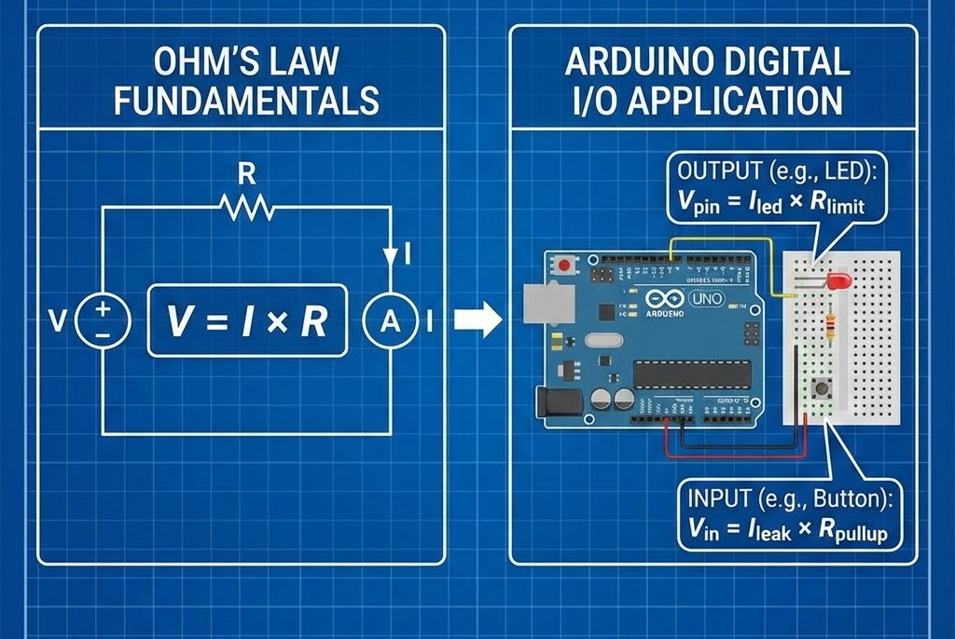

Recap: Lecture 3
Ohm's Law: V = I × R is the golden rule.
Digital I/O: Pins can be HIGH (5V) or LOW (0V).
Functions: pinMode(), digitalWrite(), digitalRead().
Today's Goal:
hardware theory
software workshop

Slide 3


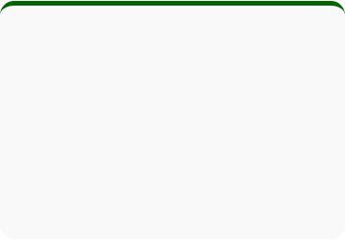

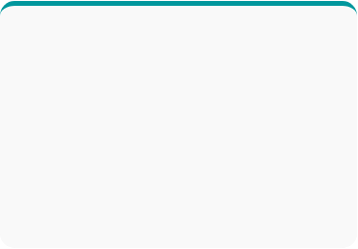



What is an IDE?
Integrated Development Environment
Text Editor
Compiler
Uploader
Where you write your code.
Translates code to machine language (Hex).
Sends the binary to the Arduino board.

Slide 4



The Arduino Interface
sketch_nov29a
void setup() {
// setup code here
}
void loop() {
// main code here
}
Verify (Check): Checks your code for syntax errors.
Upload: Compiles and sends code to the board.
Console: Shows status and error messages (Black box at bottom).

Slide 5


Terminology: The "Sketch"
In the Arduino world, a program is called a "Sketch".
This naming comes from the "Processing" language, which Arduino was originally based on, designed for artists and designers.

Slide 6



Anatomy of a Sketch
Every Arduino sketch MUST have two specific functions to work:
1. void setup()
2. void loop()
Runs ONCE when power is applied or reset.
Runs REPEATEDLY forever.
Used for: Initialization, pinMode, starting Serial.
Used for: Main logic, reading sensors, blinking LEDs.

Slide 7


Deep Dive: void setup()
The Preparation Phase
void setup() {
// Prepare pin 13 as output
pinMode(13, OUTPUT);
// Start serial comms
Serial.begin(9600);
}
Think of this as "packing your bag" before a trip.
•
You only pack once.
•
You define your tools (Inputs/Outputs).
•
You set your communication speed.

Slide 8

Deep Dive: void loop()
The Main Engine
Think of this as your "daily routine".
void loop() {
digitalWrite(13, HIGH);
delay(1000);
digitalWrite(13, LOW);
delay(1000);
}
// Jumps back to start!
•
It happens over and over again.
•
It executes top-to-bottom.
•
When it reaches the bottom, it jumps back to the top immediately.
Infinite Cycle

Slide 9





Visual Analogy
SETUP
LOOP
Waking Up
Daily Tasks
You only wake up once per day. You put on your clothes and shoes.
Eat -> Study -> Sleep -> Repeat. You do this continuously until the "power" goes out.

Slide 10


The Grammar of C++
Arduino uses C++, which is strict about punctuation.
void
setup
{
// Curly Braces
pinMode
OUTPUT
;
// Semicolon
}
•
Semicolons (;): End of a statement. Like a period in a sentence. Missing this is the #1 error!
•
Curly Braces { }: Define a block of code (start and end).
•
Case Sensitivity: pinMode is NOT the same as PinMode.

Slide 11

Leaving Notes: Comments
Comments are ignored by the Arduino but helpful for humans.
// This is a single line comment
delay(1000); // Wait for 1 second
/*
This is a multi-line block comment.
You can write paragraphs here.
*/

Slide 12

The Compilation Workflow

Slide 13


Don't Fear the Error!
Common Pitfalls:
1.
Syntax: Missing semicolon or unmatched curly brace.
2.
Typo: Writing digitalwrite instead of digitalWrite.
3.
Port Selection: Forgetting to select the correct COM port in Tools > Port.
Read the black console at the bottom! It tells you the line number.

Slide 14

Practical: Modifying Blink
Your Task:
1. Open File > Examples > 01.Basics > Blink.
digitalWrite(LED_BUILTIN, HIGH);
delay(1000); // Change this!
digitalWrite(LED_BUILTIN, LOW);
delay(1000);
2. Upload it and watch the LED.
3. Change the delay(1000) to delay(200).
4. Upload again. What happens?

Slide 15
Coding Best Practices
Indentation
Keep your code tidy. Use Tabs to show what is inside the curly braces.
Comments
Write comments so "Future You" knows what the code does.
Naming
Use descriptive names. ledPin is better than x.

Slide 16


Summary
IDE: The workshop where we write and upload code.
Setup(): Runs once (Initialization).
Loop(): Runs forever (Main Logic).
Syntax: Watch your semicolons and braces!

Slide 17


Questions?
"The only stupid question is the one you don't ask."
Dr. Kadeghe Fue
Sokoine University of Agriculture

